Slide 1
Reconstructing dynamics from snapshots
Carmeline Dsilva and Stanislav Shvartsman
IDeAS seminar
15 Octover 2014

Slide 2
Background
Development is stereotypic
Data types
Questions
In this case
Time scale
Data scale
What happens

Slide 3

Example Data
Live Movie
One channel, orientation and time is known
Fixed Images
Several channels, orientation and time is unknown

Slide 4
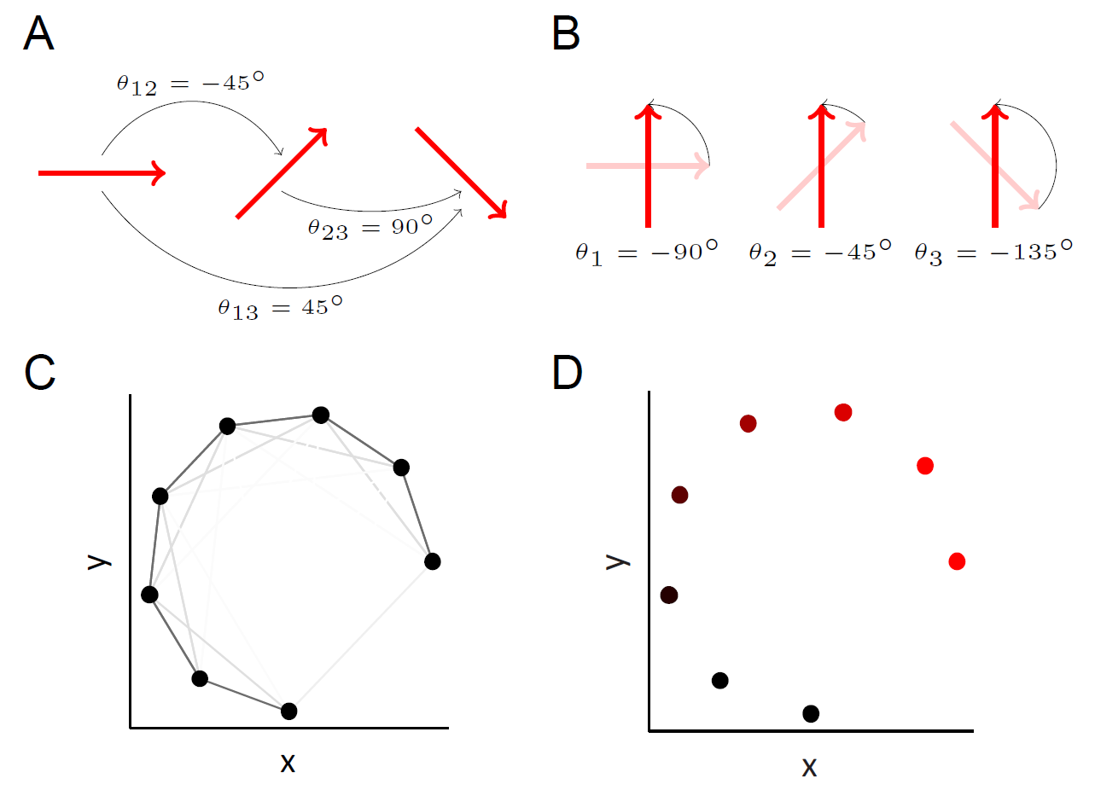
Registration and Temporal Ordering of Fixed Images
For the fixed images, both the rotational orientations and the relative times are unknown
We can register and order the images using vector diffusion maps
Vector diffusion maps will register similar images
The first VDM coordinate will parameterize developmental time/age of the images

Slide 5
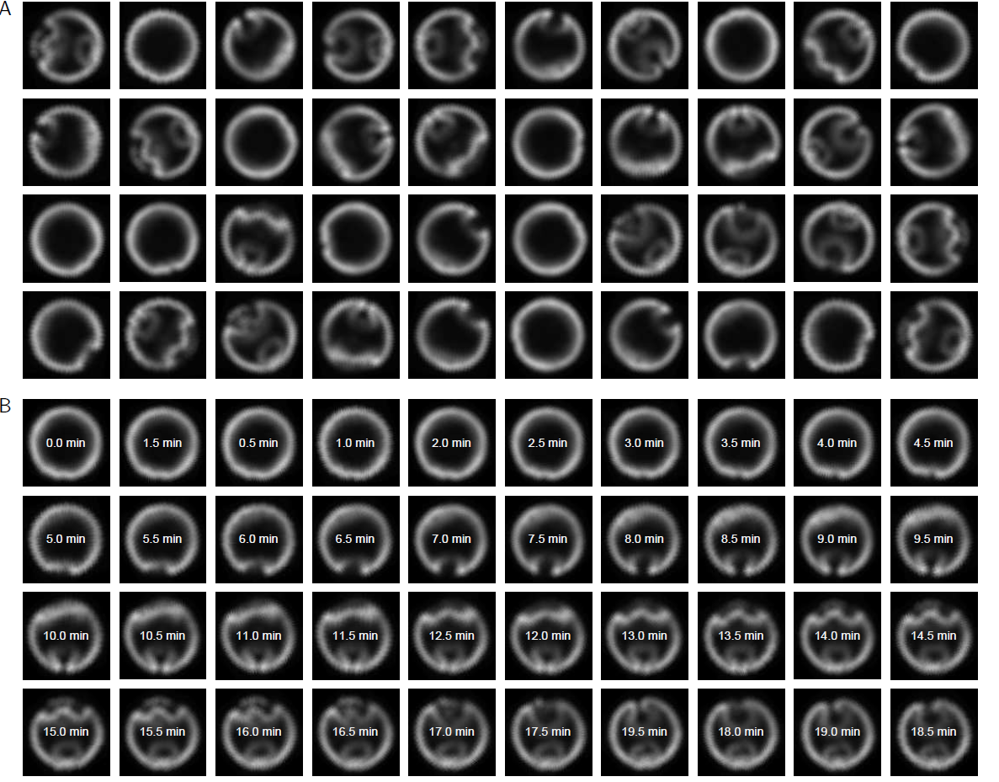
Validation of Methodology using Live Imaging
To validate using VDM as a method for registering and temporally ordering such images, we take a live movie of development, arbitrarily rotate each frame, and scramble the order of the frames
Frames from a single-channel movie, arbitrarily rotated and shuffled

Slide 6
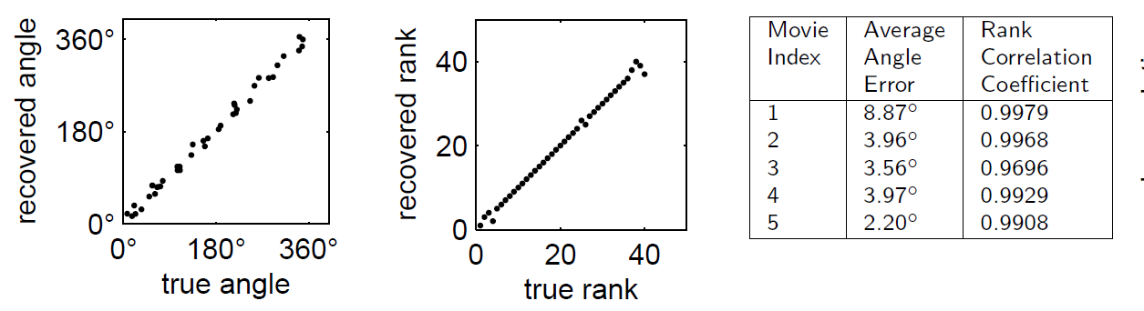
Validation of Methodology using Live Imaging
VDM can accurately and reproducibly recover the correct temporal order for relatively small data sets (<100 images)
Images, registered and ordered using VDM
The recovered angles and ranks using VDM are accurate across multiple live imaging data sets

Slide 7
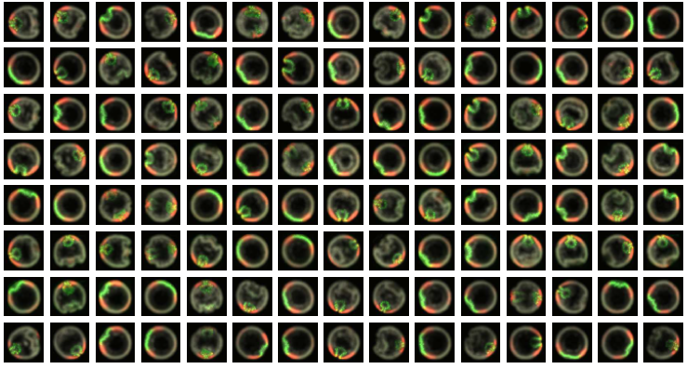
Ordering Fixed Images
We now use VDM to register and temporally order a data set of fixed images with several channels
Fixed images with three channels. Each image is from a different embryo at a different and unknown developmental time.

Slide 8
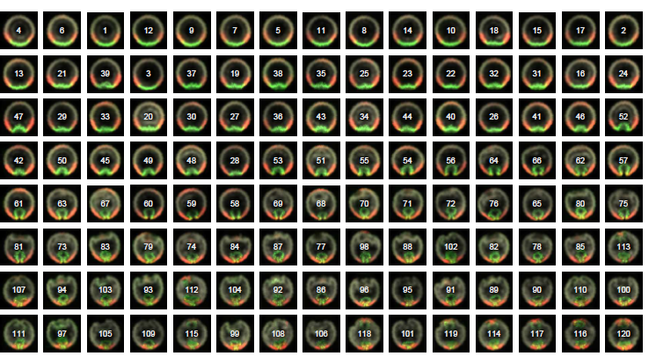
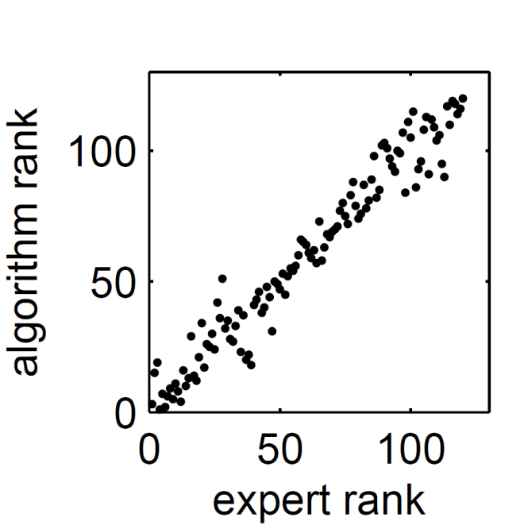
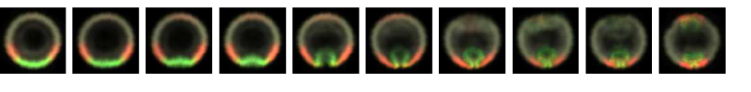
Ordering Fixed Images
The VDM ordering is consistent with the manual ordering from an embryologist
We can compute a moving average of the ordered images to obtain a “representative” developmental trajectory

Slide 9
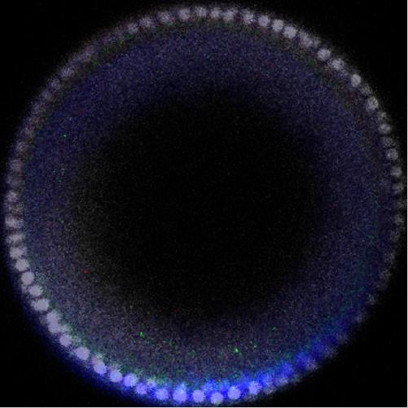
Merging Live Imaging with Fixed Images
For many applications (e.g., kinetics), we need real-time information, not only relative orders
We would like to merge the real-time single-channel live imaging data with the multiple-channel fixed data to obtain a real-time information for multiple channels.
Goal: estimate times of fixed images from live movie data
+
=

Slide 10
Principal Component Analysis to Reduce Image Dimension
Compute first five principal components from images collected from live imaging
Look at projection coefficients as a function of time

Slide 11
Linear Model to Predict Times of New Images
Fit linear regression model
time = β₀ + β₁PC₁+ β ₂PC₂ + β ₃PC₃ + β ₄PC₄ + β ₅PC₅
PC are the projection coefficients
Find β₀,…,β₅ using live imaging as training data
time =
β₀ + β₁PC₁+ β ₂PC₂
+ β ₃PC₃ + β ₄PC₄ + β ₅PC₅
= 12.37 min
Predict time (with error bars) using regression model
PC₁ =
-1191
PC₂ =
-843
PC₃ =
-272
PC₄ =
-693
PC₅ =
1000
New fixed image
Compute projection coefficients onto PCA modes

Slide 12
Interpolating Signals
1. Select frame from movie
(60 minutes)
4. Compute average over fixed images
(cross-dissolve)
2. Find fixed images which have similar times
5. Combine average fixed image with movie frame
3. Extract channels from fixed images

Slide 13
Multichannel Movie
Gray nuclei are from a live imaging study of a single embryo,
colored signals are from multiple fixed embryos

Slide 14
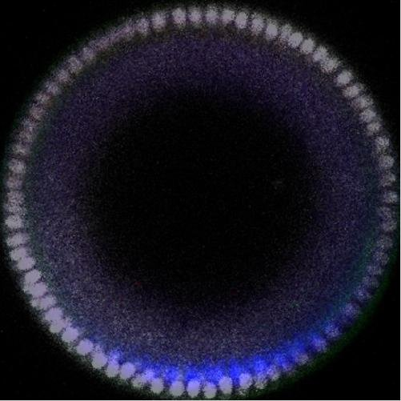
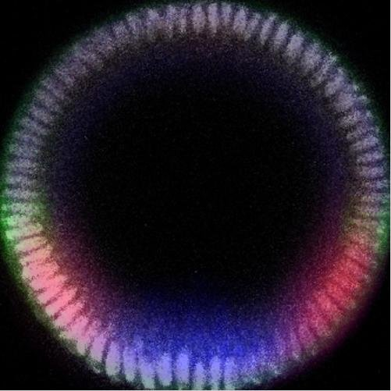
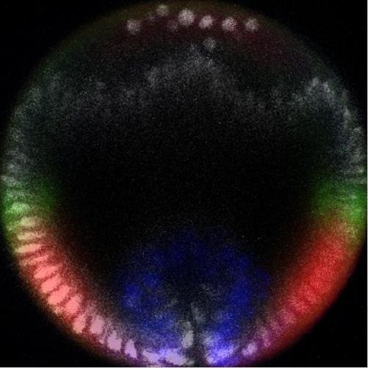
Errors in Merging Data
Signal is not localized to nuclei
This is (biologically) incorrect
Current work: local warping of images so that nuclear signals overlap

Slide 15
Future Work
Image morphing
Nonlinear time estimation
Statistics/variability in development
What are the important statistics to look at?
Want to propose model with well-defined errors/standard deviations
Lateral images
Differences from developmental times + viewing direction

